Slide 1
Ensemble Learning
Lectured by Shangsong Liang
Sun Yat-sen University
Notes:
Jing Gao, Wei Fan, Jiawei Han. Some Slides and references available at http://ews.uiuc.edu/~jinggao3/sdm10ensemble.htm

Slide 2
Outline
An overview of ensemble methods
  Motivations
  Overview
Supervised ensemble
Unsupervised ensemble
Semi-supervised ensemble
  Multi-view learning
  Consensus maximization among supervised and unsupervised models
Applications
  Transfer learning, stream classification, anomaly detection

Slide 3


Ensemble
model 1
Ensemble model
Data
model 2
……
Combine multiple models into one!
model k
Applications: classification, clustering, collaborative filtering, anomaly detection……

Slide 4
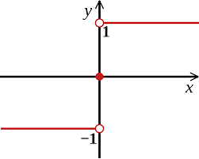
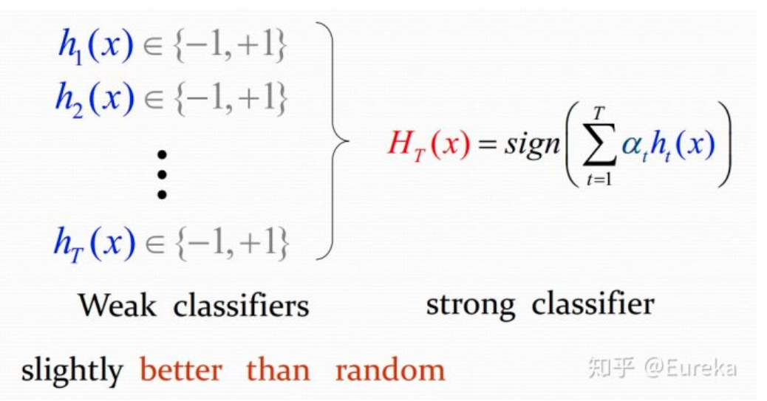

Example: Ensemble for Classification

Slide 5
How to get weak classifiers?
使用不同的弱学习算法得到不同基本学习器
2. 使用相同的弱学习算法，但用不同的参数
3. 相同输入对象的不同表示凸显事物不同的特征
4. 使用不同的训练集：装袋（bagging）也称为自举汇聚法(boostrap aggregating)与提升(boosting)

Slide 6
How to combine weak classifiers?
多专家组合：一种并行结构，所有的弱分类器都给出各自的预测结果，通过“ 组合器” 把这些预测结果转换为最终结果。eg.投票（voting）及其变种、混合专家模型
多级组合：一种串行结构，其中下一个分类器只在前一个分类器预测不够准（不够自信）的实例上进行训练或检测。eg.级联算法（cascading）

Slide 7



Stories of Success
Million-dollar prize
  Improve the baseline movie recommendation approach of Netflix by 10% in accuracy
  The top submissions all combine several teams and algorithms as an ensemble
Data mining competitions
  Classification problems
  Winning teams employ an ensemble of classifiers

Slide 8
Netflix Prize
Supervised learning task
  Training data is a set of users and ratings (1,2,3,4,5 stars) those users have given to movies.
  Construct a classifier that given a user and an unrated movie, correctly classifies that movie as either 1, 2, 3, 4, or 5 stars
  $1 million prize for a 10% improvement over Netflix’s current movie recommender
Competition
  At first, single-model methods are developed, and performances are improved
  However, improvements slowed down
  Later, individuals and teams merged their results, and significant improvements are observed

Slide 9
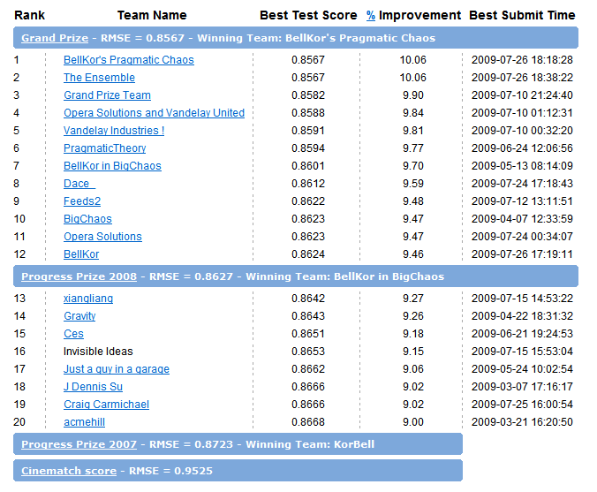
Leaderboard
“Our final solution (RMSE=0.8712) consists of blending 107 individual results. “
“Predictive accuracy is substantially improved when blending multiple predictors. Our experience is that most efforts should be concentrated in deriving substantially different approaches, rather than refining a single technique. ”

Slide 10
Motivations
Motivations of ensemble methods
  Ensemble model improves accuracy and robustness over single model methods
  Applications:
    distributed computing
    privacy-preserving applications
    large-scale data with reusable models
    multiple sources of data
  Efficiency: a complex problem can be decomposed into multiple sub-problems that are easier to understand and solve (divide-and-conquer approach)

Slide 11
Relationship with Related Studies (1)
Multi-task learning
  Learn multiple tasks simultaneously
  Ensemble methods: use multiple models to learn one task
Data integration
  Integrate raw data
  Ensemble methods: integrate information at the model level

Slide 12
Relationship with Related Studies (2)
Meta learning
  Learn on meta-data (include base model output)
  Ensemble methods: besides learn a joint model based on model output, we can also combine the output by consensus
Non-redundant clustering
  Give multiple non-redundant clustering solutions to users
  Ensemble methods: give one solution to users which represents the consensus among all the base models

Slide 13
Why Ensemble Works? (1)
Intuition
  Combining diverse, independent opinions in human decision-making as a protective mechanism (e.g. stock portfolio)
Uncorrelated error reduction
  Suppose we have 5 completely independent classifiers for majority voting
  If accuracy is 70% for each
    10 (.7^3)(.3^2)+5(.7^4)(.3)+(.7^5)
    83.7% majority vote accuracy
  101 such classifiers
    99.9% majority vote accuracy
from T. Holloway, Introduction to Ensemble Learning, 2007.

Slide 14
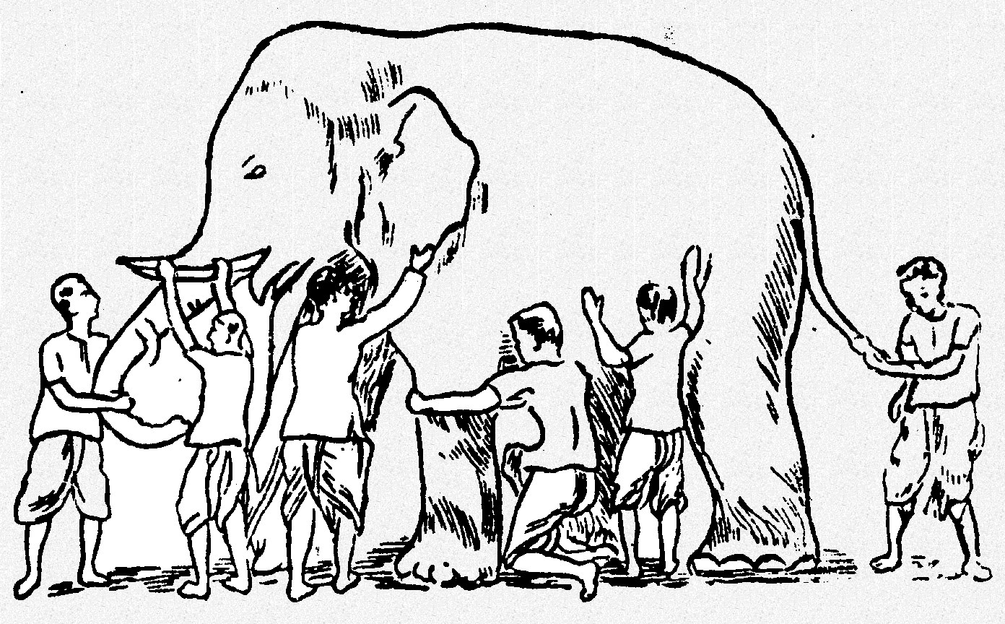
Why Ensemble Works? (2)
Some unknown distribution
Model 1
Model 6
Model 3
Model 5
Model 2
Model 4
Ensemble gives the global picture!

Slide 15
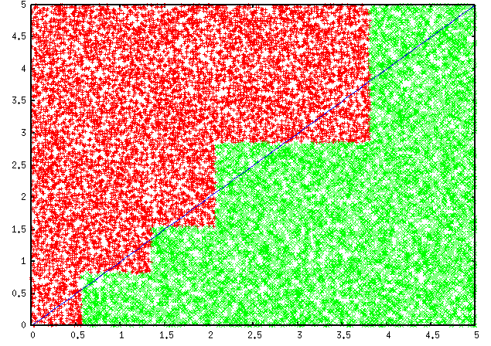
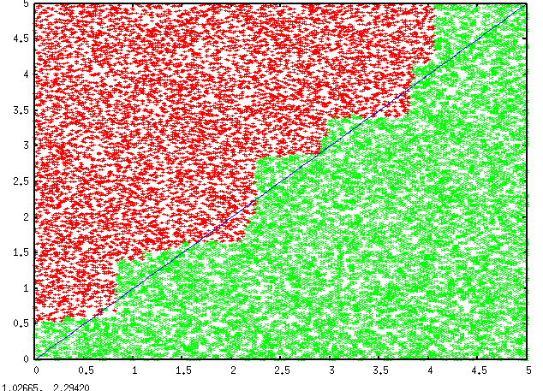
Why Ensemble Works? (3)
Overcome limitations of single hypothesis
  The target function may not be implementable with individual classifiers, but may be approximated by model averaging
Decision Tree
Model Averaging

Slide 16
Research Focus
Base models
  Improve diversity!
Combination scheme
  Consensus (unsupervised)
  Learn to combine (supervised)
Tasks
  Classification (supervised or semi-supervised ensemble )
  Clustering (unsupervised ensemble)

Slide 17
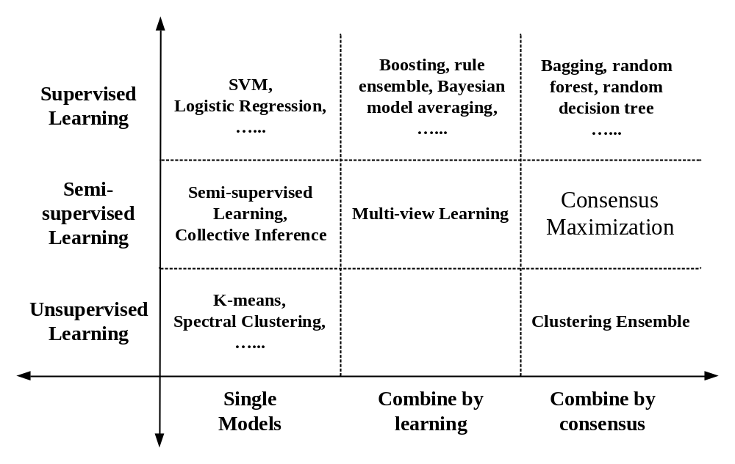
Summary
Review the ensemble methods in the tutorial

Slide 18
Ensemble of Classifiers—Learn to Combine
training
test
classifier 1
Ensemble model
labeled
data
unlabeled
data
classifier 2
……
classifier k
final
predictions
learn the combination from labeled data
Algorithms: boosting, stacked generalization, rule ensemble, Bayesian model averaging……

Slide 19
Ensemble of Classifiers—Consensus
training
test
classifier 1
unlabeled
data
combine the predictions by majority voting
labeled
data
classifier 2
……
classifier k
final
predictions
Algorithms: bagging, random forest, random decision tree, model averaging of probabilities……

Slide 20
Clustering Ensemble—Consensus
clustering algorithm 1
clustering algorithm 2
unlabeled
data
combine the partitionings by consensus
……
……
clustering algorithm k
final
clustering
Algorithms: direct approach, object-based, cluster-based, object-cluster-based approaches, generative models

Slide 21
Semi-Supervised Ensemble—Learn to Combine
training
test
classifier 1
Ensemble model
labeled
data
unlabeled
data
classifier 2
……
classifier k
final
predictions
learn the combination from both labeled and unlabeled data
Algorithms: multi-view learning

Slide 22
Semi-supervised Ensemble—Consensus
classifier 1
labeled
data
classifier 2
……
unlabeled
data
combine all the supervised and unsupervised results by consensus
classifier k
clustering 1
final
predictions
clustering 2
……
……
clustering h
Algorithms: consensus maximization

Slide 23
Pros and Cons
 | Combine by learning | Combine by consensus
Pros | Get useful feedbacks from labeled data Can potentially improve accuracy | Do not need labeled data Can improve the generalization performance
Cons | Need to keep the labeled data to train the ensemble May overfit the labeled data Cannot work when no labels are available | No feedbacks from the labeled data Require the assumption that consensus is better

Slide 24
Outline
An overview of ensemble methods
  Motivations
  Tutorial overview
Supervised ensemble
Unsupervised ensemble
Semi-supervised ensemble
  Multi-view learning
  Consensus maximization among supervised and unsupervised models
Applications
  Transfer learning, stream classification, anomaly detection

Slide 25
Supervised Ensemble Methods
Problem
  Given a data set D={x₁,x₂,…,x_{n}} and their corresponding labels L={l₁,l₂,…,l_{n}}
  An ensemble approach computes:
    A set of classifiers {f₁,f₂,…,f_{k}}, each of which maps data to a class label: f_{j}(x)=l
    A combination of classifiers f* which minimizes generalization error: f*(x)= w₁f₁(x)+ w₂f₂(x)+…+ w_{k}f_{k}(x)

Slide 26
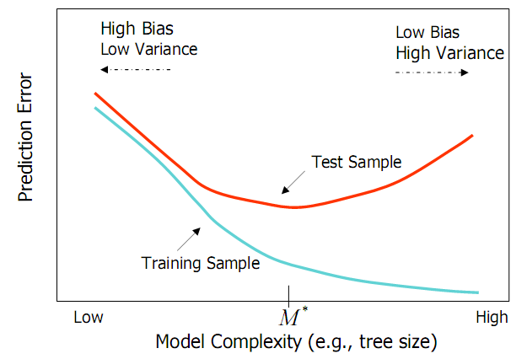
Bias and Variance
Ensemble methods
  Combine learners to reduce variance
from Elder, John. From Trees to Forests and Rule Sets - A Unified Overview of Ensemble Methods. 2007.

Slide 27
Generating Base Classifiers
Sampling training examples
  Train k classifiers on k subsets drawn from the training set
Using different learning models
  Use all the training examples, but apply different learning algorithms
Sampling features
  Train k classifiers on k subsets of features drawn from the feature space
Learning “randomly”
  Introduce randomness into learning procedures

Slide 28
Bagging* (1)
Bootstrap
  Sampling with replacement
  Contains around 63.2% original records in each sample
Bootstrap Aggregation
  Train a classifier on each bootstrap sample
  Use majority voting to determine the class label of ensemble classifier
*[Breiman96]

Slide 29
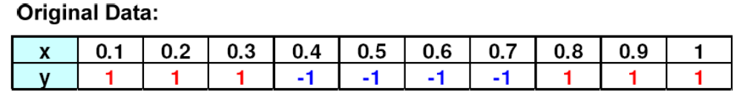
Bagging (2)
Bootstrap samples and classifiers:
Combine predictions by majority voting
from P. Tan et al. Introduction to Data Mining.

Slide 30

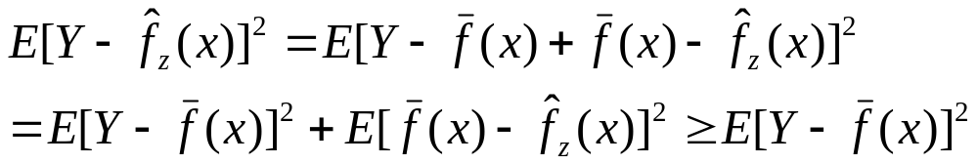
Bagging (3)
Error Reduction
  Under mean squared error, bagging reduces variance and leaves bias unchanged
  Consider idealized bagging estimator:
  The error is
  Bagging usually decreases MSE
from Elder, John. From Trees to Forests and Rule Sets - A Unified Overview of Ensemble Methods. 2007.

Slide 31
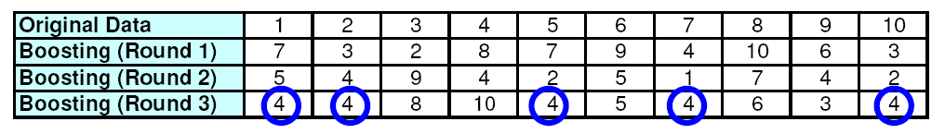
Boosting* (1)
Principles
  Boost a set of weak learners to a strong learner
  Make records currently misclassified more important
Example
  Record 4 is hard to classify
  Its weight is increased, therefore it is more likely to be chosen again in subsequent rounds
*[FrSc97]
from P. Tan et al. Introduction to Data Mining.

Slide 32
Boosting (2)
AdaBoost
  Initially, set uniform weights on all the records
  At each round
    Create a bootstrap sample based on the weights
    Train a classifier on the sample and apply it on the original training set
    Records that are wrongly classified will have their weights increased
    Records that are classified correctly will have their weights decreased
    If the error rate is higher than 50%, start over
  Final prediction is weighted average of all the classifiers with weight representing the training accuracy

Slide 33
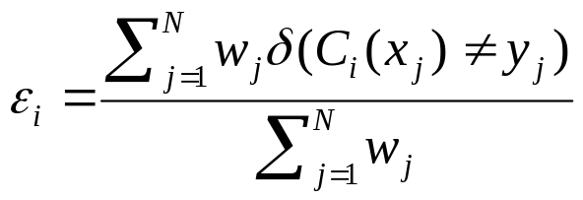
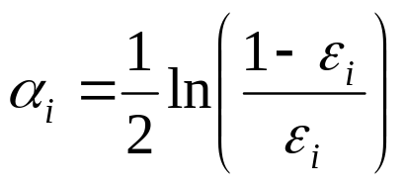
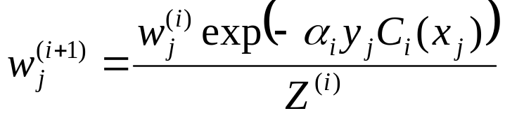
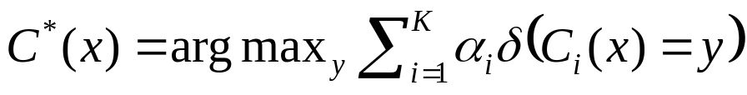
Boosting (3)
Determine the weight
  For classifier i, its error is
  The classifier’s importance is represented as:
  The weight of each record is updated as:
  Final combination:

Slide 34
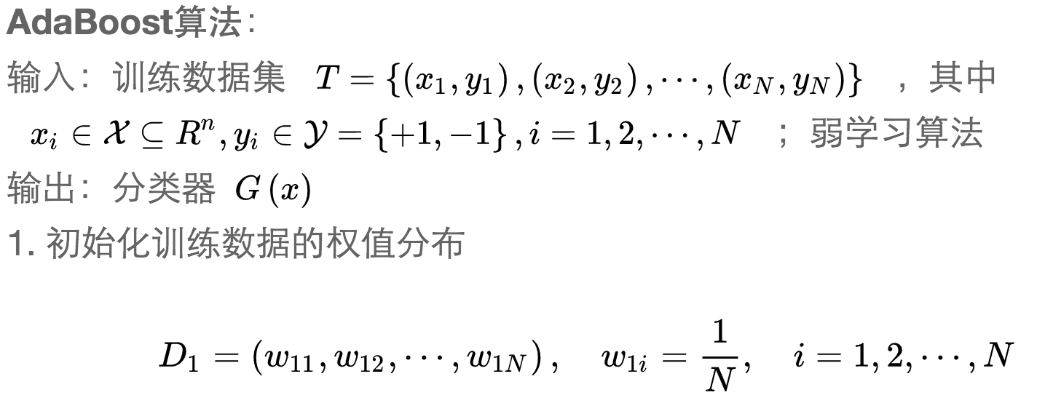

Slide 35
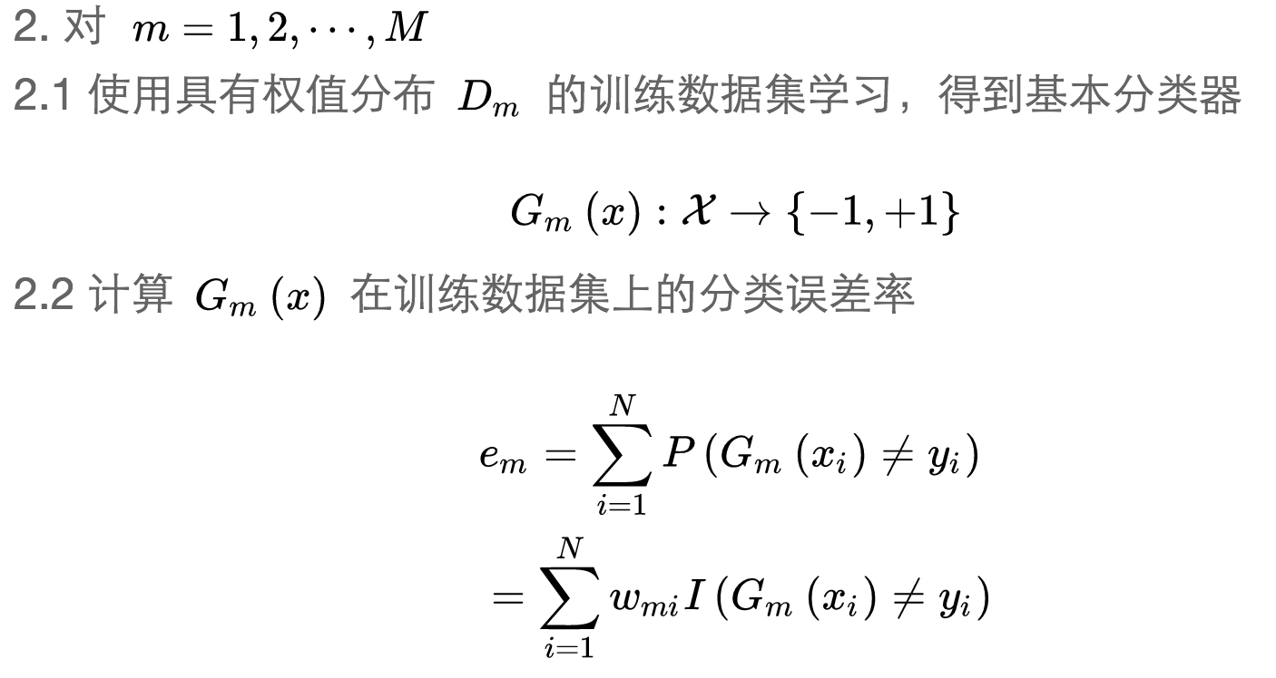

Slide 36
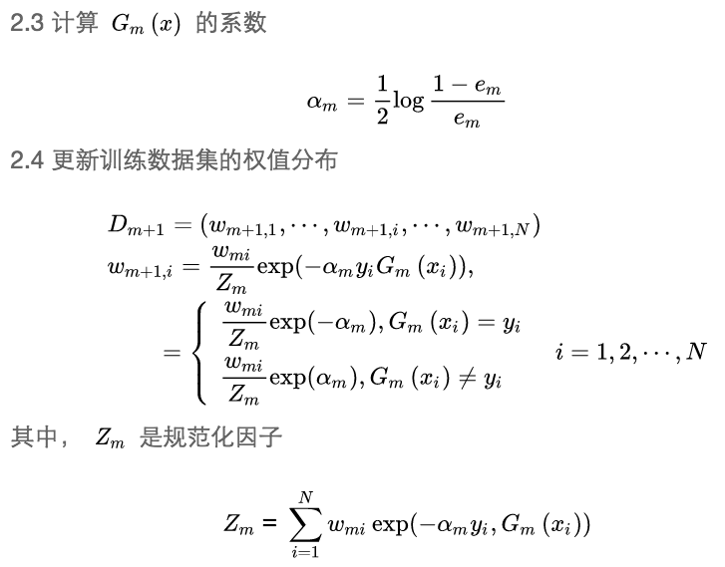

Slide 37
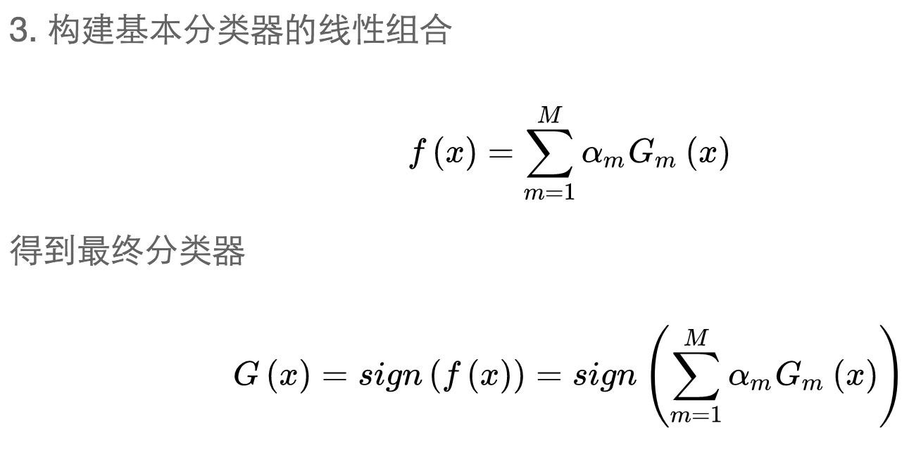

Slide 38
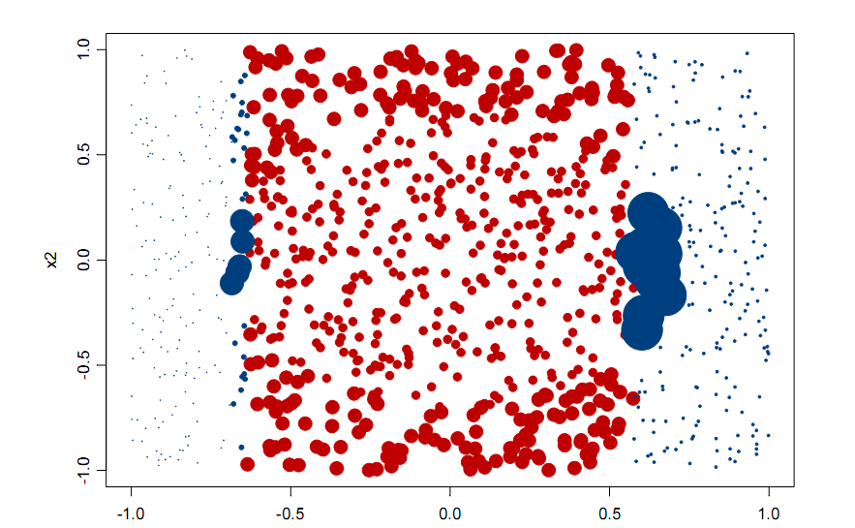
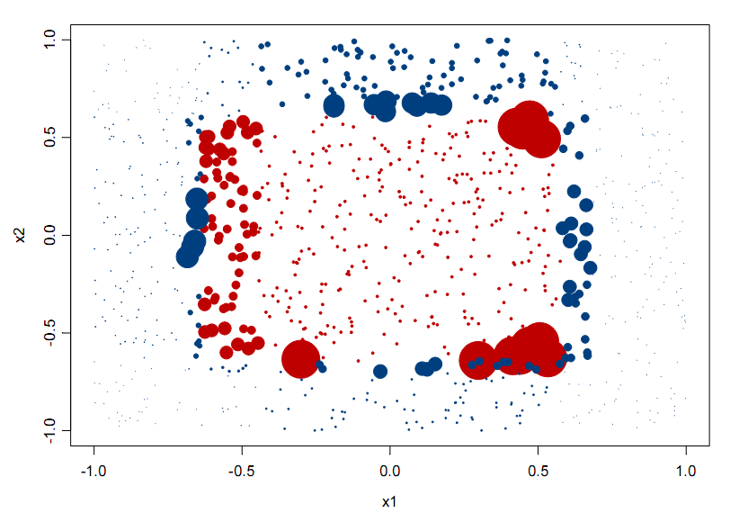
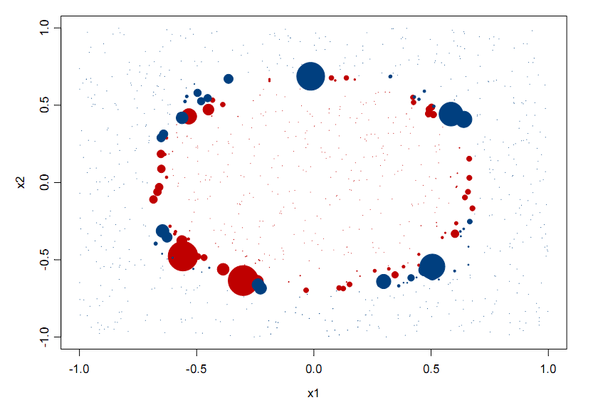
Classifications (colors) and
Weights (size) after 1 iteration
Of AdaBoost
20 iterations
3 iterations
from Elder, John. From Trees to Forests and Rule Sets - A Unified Overview of Ensemble Methods. 2007.
Notes:
Note after 1 iteration the step classes of a single decision tree.

Slide 39
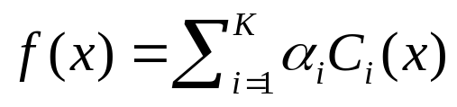
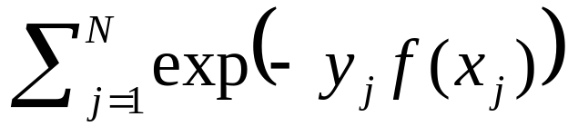
Boosting (4)
Explanation
  Among the classifiers of the form:
  We seek to minimize the exponential loss function:
  Not robust in noisy settings

Slide 40
Random Forests* (1)
Algorithm
  Choose T—number of trees to grow
  Choose m<M (M is the number of total features) —number of features used to calculate the best split at each node (typically 20%)
  For each tree
    Choose a training set by choosing N times (N is the number of training examples) with replacement from the training set
    For each node, randomly choose m features and calculate the best split
    Fully grown and not pruned
  Use majority voting among all the trees
*[Breiman01]

Slide 41
Random Forests (2)
Discussions
  Bagging+random features
  Improve accuracy
    Incorporate more diversity and reduce variances
  Improve efficiency
    Searching among subsets of features is much faster than searching among the complete set

Slide 42
Random Decision Tree* (1)
Single-model learning algorithms
  Fix structure of the model, minimize some form of errors, or maximize data likelihood (eg., Logistic regression, Naive Bayes, etc.)
  Use some “free-form” functions to match the data given some “preference criteria” such as information gain, gini index and MDL. (eg., Decision Tree, Rule-based Classifiers, etc.)
Such methods will make mistakes if
  Data is insufficient
  Structure of the model or the preference criteria is inappropriate for the problem
Learning as Encoding
  Make no assumption about the true model, neither parametric form nor free form
  Do not prefer one base model over the other, just average them
*[FWM+03]

Slide 43
Random Decision Tree (2)
Algorithm
  At each node, an un-used feature is chosen randomly
    A discrete feature is un-used if it has never been chosen previously on a given decision path starting from the root to the current node.
    A continuous feature can be chosen multiple times on the same decision path, but each time a different threshold value is chosen
  We stop when one of the following happens:
    A node becomes too small (<= 3 examples).
    Or the total height of the tree exceeds some limits, such as the total number of features.
  Prediction
    Simple averaging over multiple trees

Slide 44
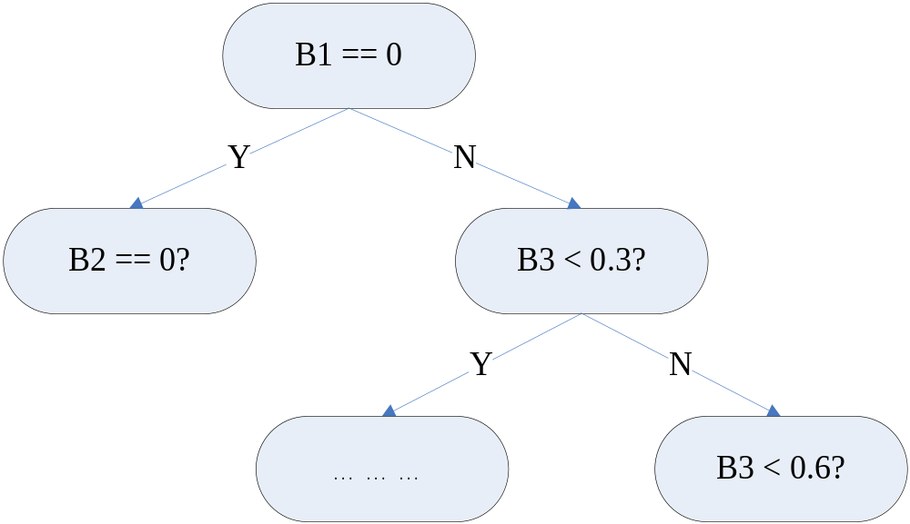
Random Decision Tree (3)
B1: {0,1}
B2: {0,1}
B3: continuous
B1 chosen randomly
Random threshold 0.3
B2: {0,1}
B3: continuous
B2: {0,1}
B3: continuous
B3 chosen randomly
B2 chosen randomly
Random threshold 0.6
B3: continous

Slide 45
Random Decision Tree (4)
Potential Advantages
  Training can be very efficient. Particularly true for very large datasets.
    No cross-validation based estimation of parameters for some parametric methods.
  Natural multi-class probability.
  Imposes very little about the structures of the model.

Slide 46
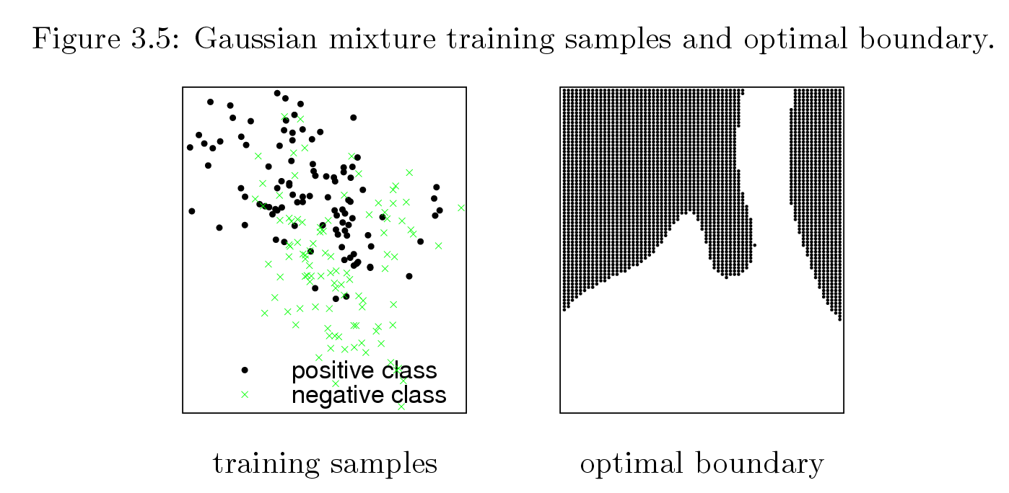
Optimal Decision Boundary
from Tony Liu’s thesis (supervised by Kai Ming Ting)

Slide 47
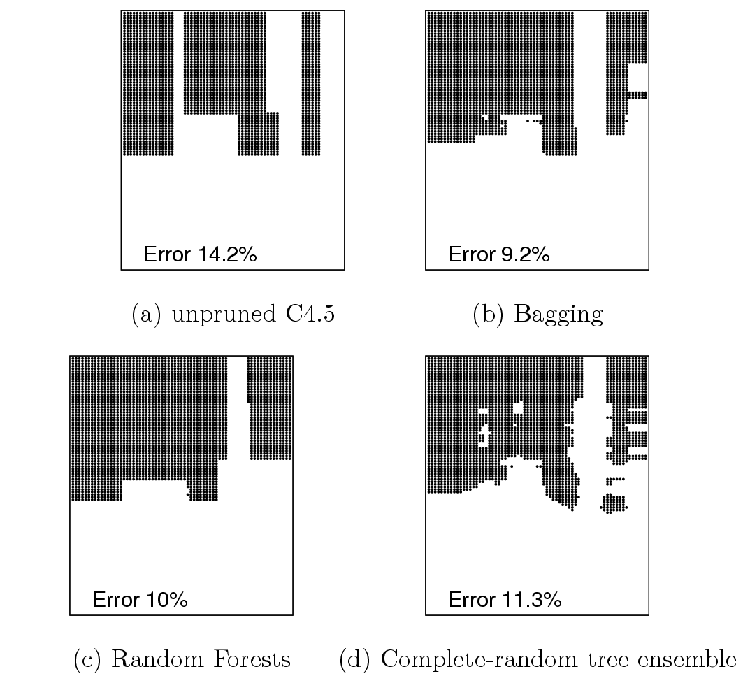
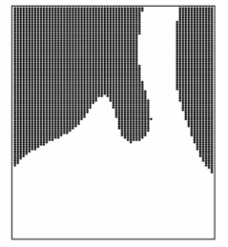
RDT looks
like the optimal
boundary

Slide 48
Outline
An overview of ensemble methods
  Motivations
  Tutorial overview
Supervised ensemble
Unsupervised ensemble
Semi-supervised ensemble
  Multi-view learning
  Consensus maximization among supervised and unsupervised models
Applications
  Transfer learning, stream classification, anomaly detection

Slide 49
Clustering Ensemble
Problem
  Given an unlabeled data set D={x₁,x₂,…,x_{n}}
  An ensemble approach computes:
    A set of clustering solutions {C₁,C₂,…,C_{k}}, each of which maps data to a cluster: f_{j}(x)=m
    A unified clustering solutions f* which combines base clustering solutions by their consensus
Challenges
  The correspondence between the clusters in different clustering solutions is unknown
  Unsupervised
  Combinatorial optimization problem-NP-complete

Slide 50
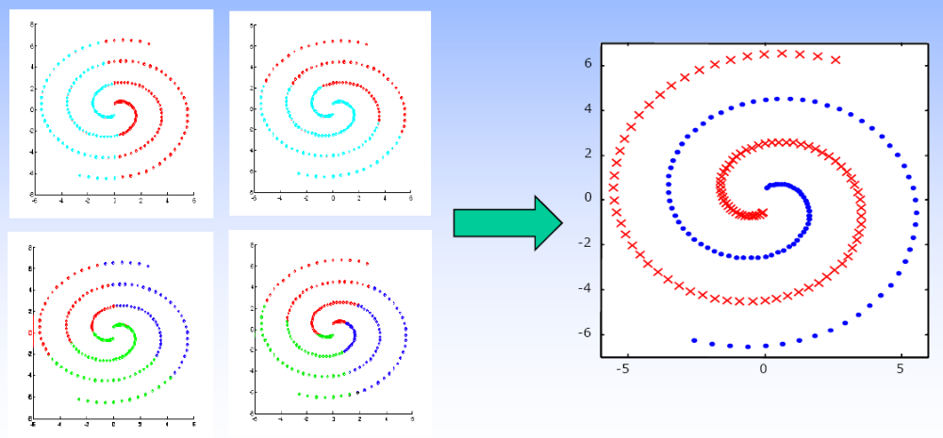
Motivations
Goal
  Combine “weak” clusterings to a better one
[PTJ05]

Slide 51
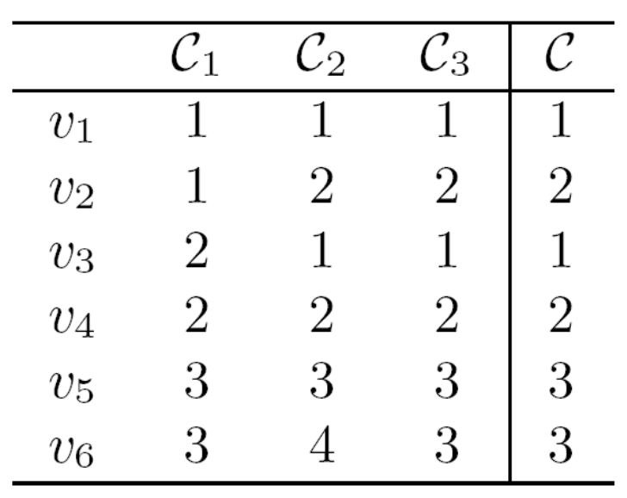
An Example
base clustering models
objects
they may not represent the same cluster!
The goal: get the consensus clustering
[GMT07]

Slide 52
Methods (1)
How to get base models?
  Bootstrap samples
  Different subsets of features
  Different clustering algorithms
  Random number of clusters
  Random initialization for K-means
  Incorporating random noises into cluster labels
  Varying the order of data in on-line methods such as BIRCH

Slide 53
Methods (2)
How to combine the models?
Correspondence
Explicit
Implicit
Generative
Approaches
Consensus
Function
Representation
Optimization
Method
Object-based
Cluster-based
Object-Cluster
-based

Slide 54
Hard Correspondence (1)
Re-labeling+voting
  Find the correspondence between the labels in the partitions and fuse the clusters with the same labels by voting [DuFr03,DWH01]
Re-labeling
Voting
 | C₁ | C₂ | C₃
v₁ | 1 | 3 | 2
v₂ | 1 | 3 | 2
v₃ | 2 | 1 | 2
v₄ | 2 | 1 | 3
v₅ | 3 | 2 | 1
v₆ | 3 | 2 | 1
 | C₁ | C₂ | C₃
v₁ | 1 | 1 | 1
v₂ | 1 | 1 | 1
v₃ | 2 | 2 | 1
v₄ | 2 | 2 | 2
v₅ | 3 | 3 | 3
v₆ | 3 | 3 | 3
C*
1
1
2
2
3
3

Slide 55
Hard Correspondence (2)
Details
  Hungarian method to match clusters in two different clustering solutions
  Match to a reference clustering or match in a pairwise manner
Problems
  In most cases, clusters do not have one-to-one correspondence

Slide 56
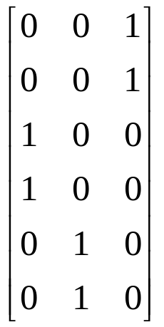
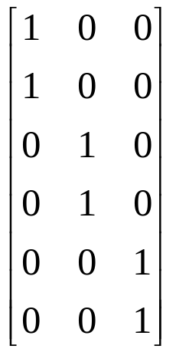
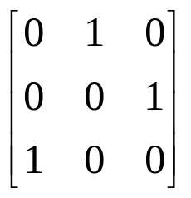
Soft Correspondence* (1)
Notations
  Membership matrix M₁, M₂, … ,M_{k}
  Membership matrix of consensus clustering M
  Correspondence matrix S₁, S₂, … ,S_{k}
  M_{i} S_{i} =M
 | C₁ | C₂ | C₃
v₁ | 1 | 3 | 2
v₂ | 1 | 3 | 2
v₃ | 2 | 1 | 2
v₄ | 2 | 1 | 3
v₅ | 3 | 2 | 1
v₆ | 3 | 2 | 1
M₂
S₂
M
X
=
*[LZY05]

Slide 57
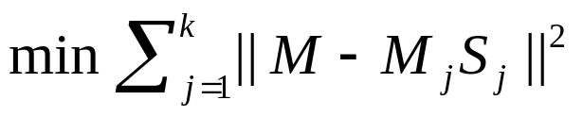
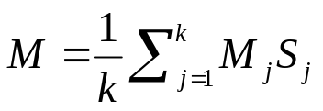
Soft Correspondence (2)
Consensus function
  Minimize disagreement
  Constraint 1: column-sparseness
  Constraint 2: each row sums up to 1
  Variables: M, S₁, S₂, … ,S_{k}
Optimization
  EM-based approach
  Iterate until convergence
    Update S using gradient descent
    Update M as

Slide 58
How to combine the models?
Correspondence
Explicit
Implicit
Generative
Approaches
Consensus
Function
Representation
Optimization
Method
Object-based
Cluster-based
Object-Cluster
-based

Slide 59
Object-based Methods (1)
Clustering objects
  Define a similarity or distance measure:
    Similarity between two objects can be defined as the percentage of clusterings that assign the two objects into same clusters
    Distance between two objects can be defined as the percentage of clusterings that assign the two objects into different clusters
  Conduct clustering on the new similarity (distance) matrix
  Result clustering represents the consensus
  Can view this approach as clustering in the new feature space where clustering results are the categorical features

Slide 60
Object-based Methods (2)
v2
v1
v4
v3
v5
v6

Slide 61
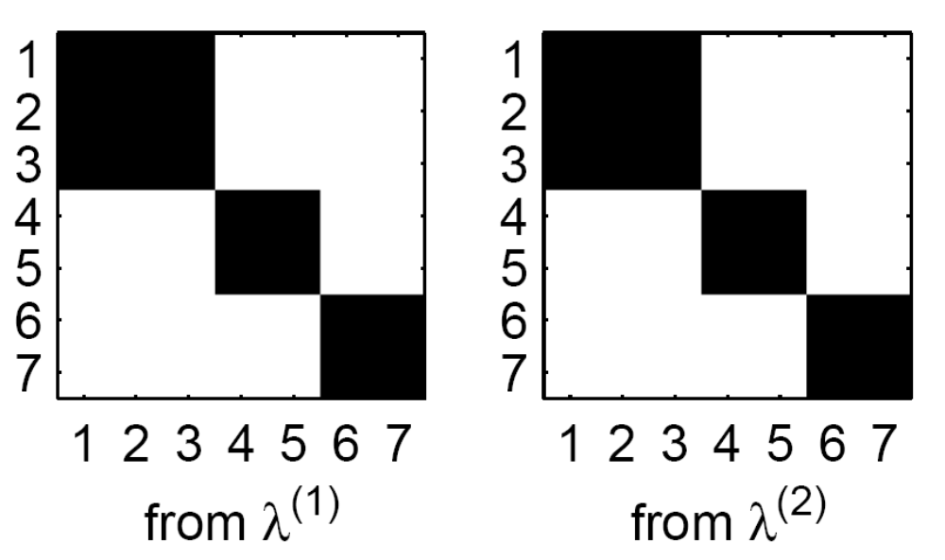
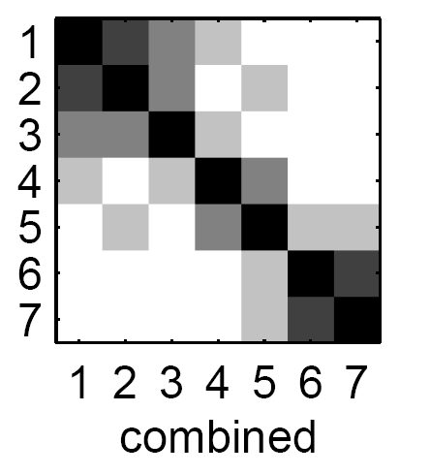
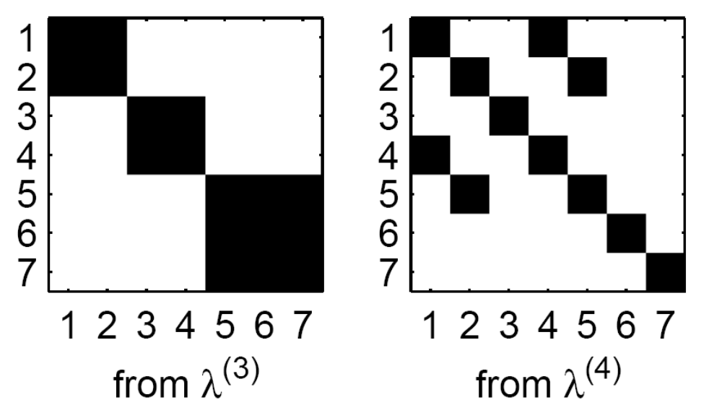
Co-association matrix T
[StGh03]

Slide 62
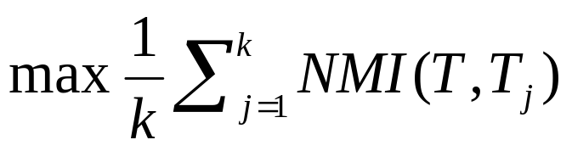
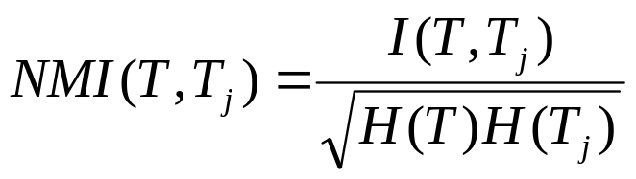
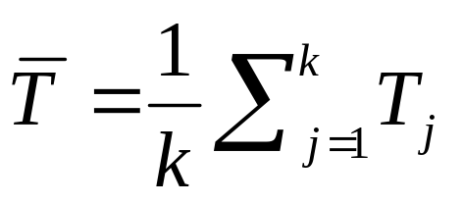
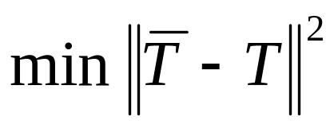
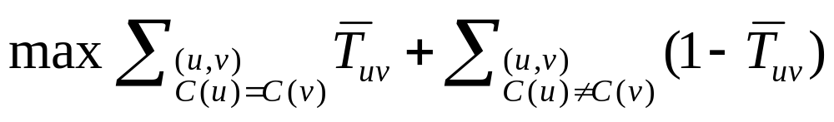
Consensus Function
Minimizing disagreement
  Information-theoretic [StGh03]
  Median partition [LDJ07]
  Correlation clustering [GMT07]

Slide 63
Optimization Method
Approximation
  Agglomerative clustering (bottom-up) [FrJa02,GMT07]
    Single link, average link, complete link
  Divisive clustering (top-down) [GMT07]
    Furthest
  LocalSearch [GMT07]
    Place an object into a different cluster if objective function improved
    Iterate the above until no improvements can be made
  BestClustering [GMT07]
    Select the clustering that maximize (minimize) the objective function
  Graph partitioning [StGh03]
  Nonnegative matrix factorization [LDJ07,LiDi08]

Slide 64
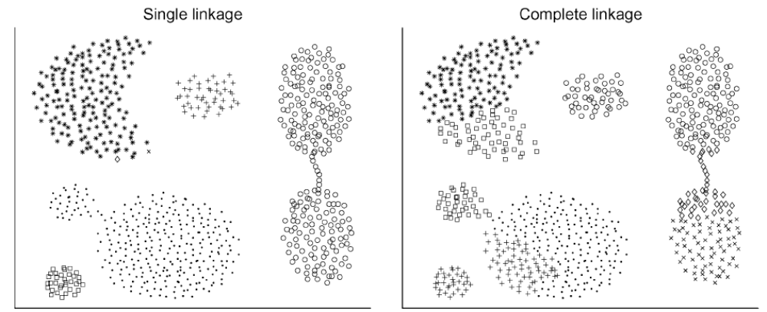
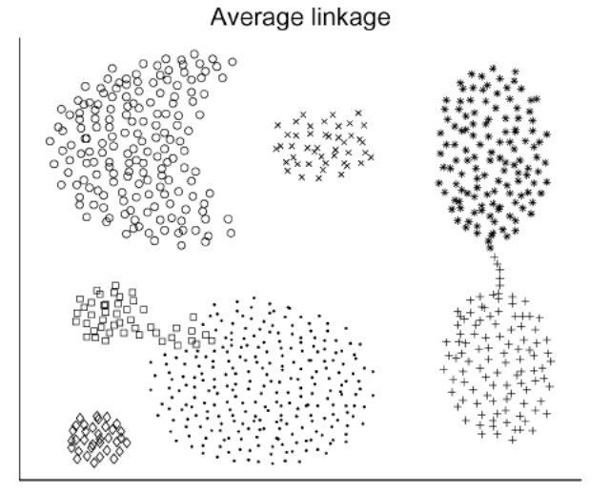
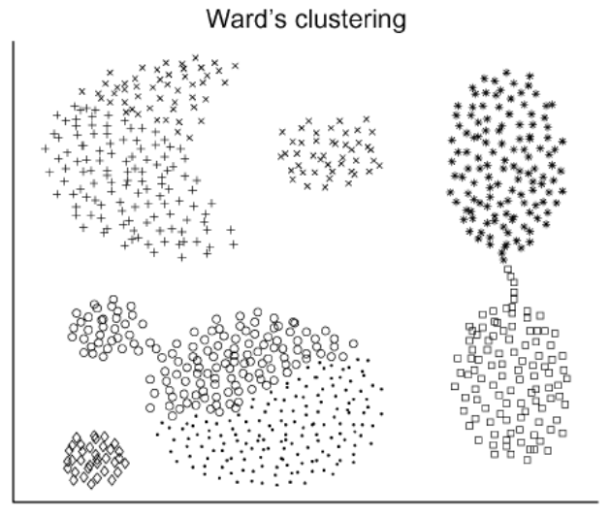
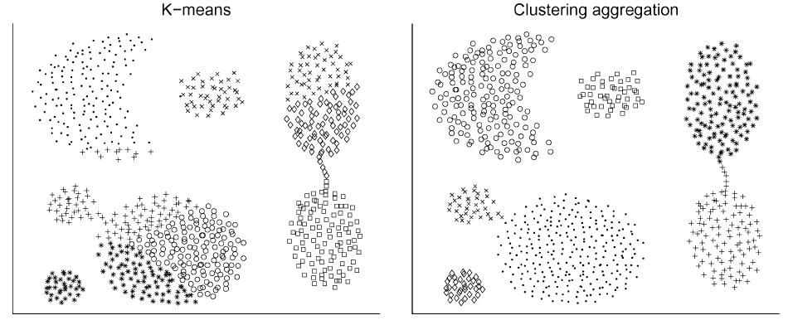
[GMT07]

Slide 65
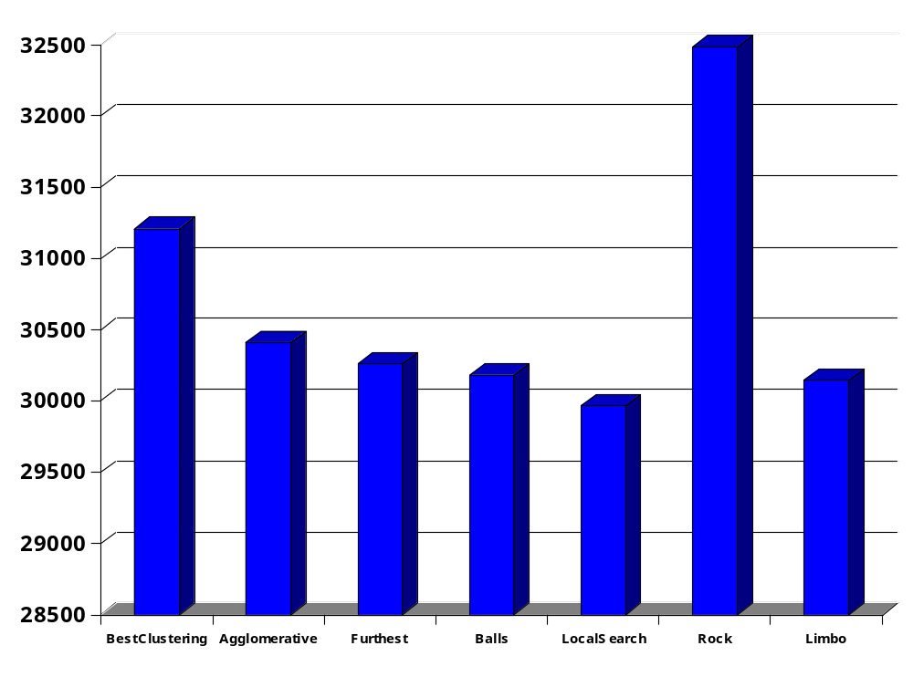
Overall Distance on Votes data set
[GMT07]

Slide 66
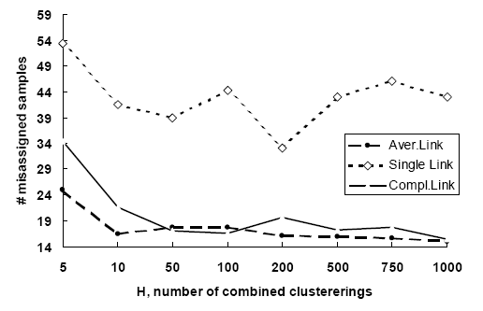
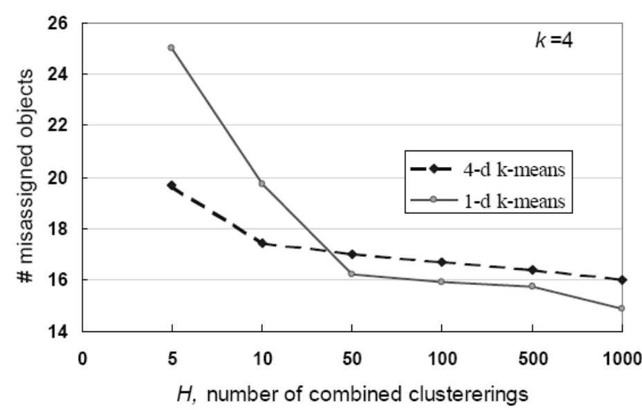

Iris data set
Algorithm: agglomerative clustering
k: number of clusters
H: number of clusterings
[PTJ05]

Slide 67
How to combine the models?
Correspondence
Explicit
Implicit
Generative
Approaches
Consensus
Function
Representation
Optimization
Method
Object-based
Cluster-based
Object-Cluster
-based

Slide 68
Cluster-based Methods
Clustering clusters
  Regard each cluster from a base model as a record
  Similarity is defined as the percentage of shared common objects
    eg. Jaccard measure
  Conduct clustering on these clusters
  Assign an object to its most associated consensus cluster

Slide 69
Meta-Clustering Algorithm (MCLA)*
M₁
M₂
M₁
M₂
M₃
g2
g5
3 0 0
g1
g3
g4
g6
2 0
2 1 0
g7
0 3 0
g8
M₃
0 0 3
g9
g10
0 0 3
*[StGh03]

Slide 70
How to combine the models?
Correspondence
Explicit
Implicit
Generative
Approaches
Consensus
Function
Representation
Optimization
Method
Object-based
Cluster-based
Object-Cluster
-based

Slide 71
HyperGraph-Partitioning Algorithm (HGPA)*
Hypergraph representation and clustering
  Each node denotes an object
  A hyperedge is a generalization of an edge in that it can connect any number of nodes
  For objects that are put into the same cluster by a clustering algorithm, draw a hyperedge connecting them
  Partition the hypergraph by minimizing the number of cut hyperedges
  Each component forms a consensus cluster
*[StGh03]

Slide 72
HyperGraph-Partitioning Algorithm (HGPA)
v2
v1
v4
v3
v5
v6
Hypergraph representation– a circle denotes a hyperedge

Slide 73



Halfrings dataset
Object-based:
Agglomerative: Single link, Avg. link, Comp. link
METIS: CSPA
Quadratic mutual information: QMI
Cluster-based: MCLA
Object-cluster-based: HPGA
[MTP04]

Slide 74
Bipartite Graph Partitioning*
Hybrid Bipartite Graph Formulation
  Summarize base model output in a bipartite graph
  Lossless summarization—base model output can be reconstructed from the bipartite graph
  Use spectral clustering algorithm to partition the bipartite graph
  Time complexity O(nkr)—due to the special structure of the bipartite graph
  Each component represents a consensus cluster
*[FeBr04]

Slide 75
Bipartite Graph Partitioning
clusters
c1
c2
c3
c4
c5
c6
v1
v2
v3
v4
v5
v6
objects
c7
c8
c9
c10
clusters

Slide 76




Integer Programming*
Three-dimensional representation
  Object l, cluster i, clustering algorithm j
Objective function
  Median partition
If object l is assigned to cluster i by algorithm j
If object l is assigned to cluster i’ by the consensus output
For algorithm j, cluster i has the largest overlapping with cluster i’ in the consensus output
*[SMP+07]

Slide 77




Slide 78
How to combine the models?
Correspondence
Explicit
Implicit
Generative
Approaches
Consensus
Function
Representation
Optimization
Method
Object-based
Cluster-based
Object-Cluster
-based

Slide 79

A Mixture Model of Consensus*
Probability-based
  Assume output comes from a mixture of models
  Use EM algorithm to learn the model
Generative model
  The clustering solutions for each object are represented as nominal features--v_{i}
  v_{i} is described by a mixture of k components, each component follows a multinomial distribution
  Each component is characterized by distribution parameters
*[PTJ05]

Slide 80

EM Method
Maximize log likelihood
Hidden variables
  z_{i} denotes which consensus cluster the object belongs to
EM procedure
  E-step: compute expectation of z_{i}
  M-step: update model parameters to maximize likelihood

Slide 81


Slide 82


Slide 83

Error rate (%) on Halfrings data set

Slide 84



Bayesian Clustering Ensemble*
Consensus cluster—topic
Cluster in base clustering—word
Object—document
*[WSB09]

Slide 85
Other Research Problems
Consensus Clustering Theory
  Consensus clustering converges to true clustering as the number of base clustering models increases [TLJ+04]
  Error incurred by approximation has a lower bound [GMT07,GoFi08]
Base model selection
  Ensemble selection [FeLi08]
  Moderate diversity [HKT06,KuWh03]
Combining soft clustering
  Extend ensemble methods developed for hard clustering [PuGh08]

Slide 86

50
20
15
10
7
4
1
Ensemble
Accuracy
Number of Base Models k
Base Model Accuracy
[TLJ+04]

Slide 87
Summary of Unsupervised Ensemble
Difference from supervised ensemble
  The success of clustering ensemble approaches is shown empirically
  There exist label correspondence problems
Characteristics
  Experimental results demonstrate that cluster ensembles are better than single models!
  There is no single, universally successful, cluster ensemble method

Slide 88
Outline
An overview of ensemble methods
  Motivations
  Tutorial overview
Supervised ensemble
Unsupervised ensemble
Semi-supervised ensemble
  Multi-view learning
  Consensus maximization among supervised and unsupervised models
Applications
  Transfer learning, stream classification, anomaly detection

Slide 89




Multiple Source Classification
Image Categorization
Like? Dislike?
Research Area
movie genres, cast, director, plots…….
users viewing history, movie ratings…
publication and co-authorship network, published papers, …….
images, descriptions, notes, comments, albums, tags…….

Slide 90

Multi-view Learning
Problem
  The same set of objects can be described in multiple different views
  Features are naturally separated into K sets:
  Both labeled and unlabeled data are available
  Learning on multiple views:
    Search for labeling on the unlabeled set and target functions on X: {f₁,f₂,…,f_{k}} so that the target functions agree on labeling of unlabeled data

Slide 91

Learning from Two Views
Input
  Features can be split into two sets:
  The two views are redundant but not completely correlated
  Few labeled examples and relatively large amounts of unlabeled examples are available from the two views
Conditions
  Compatible --- all examples are labeled identically by the target concepts in each view
  Uncorrelated --- given the label of any example, its descriptions in each view are independent

Slide 92
How It Works?
Conditions
  Compatible --- Reduce the search space to where the two classifiers agree on unlabeled data
  Uncorrelated --- If two classifiers always make the same predictions on the unlabeled data, we cannot benefit much from multi-view learning
Algorithms
  Searching for compatible hypotheses
  Canonical correlation analysis
  Co-regularization
Theory
  [DLM01,BBY04,Leskes05]

Slide 93
Searching for Compatible Hypotheses
Intuitions
  Two individual classifiers are learnt from the labeled examples of the two views
  The two classifiers’ predictions on unlabeled examples are used to enlarge the size of training set
  The algorithm searches for “compatible” target functions
Algorithms
  Co-training [BlMi98]
  Co-EM [NiGh00]
  Variants of Co-training [GoZh00]

Slide 94
Labeled Data
View 1
Labeled Data
View 2
Classifier
1
Classifier
2
Unlabeled Data
View 1
Unlabeled Data
View 2

Slide 95

Co-Training*
Train two classifiers from two views
Select the top unlabeled examples with the most confident predictions from the other classifier
Add these self-labeled examples to the training set
*[BlMi98]

Slide 96

Applications: Faculty Webpages Classification
from S. K. Divvala. Co-Training & Its Applications in Vision.

Slide 97


Slide 98
Co-EM*
Algorithm
  Labeled data set L, Unlabeled data set U, Let U₁ be empty, Let U₂=U
  Iterate the following
    Train a classifier h₁ from the feature set X₁ of L and U₁
    Probabilistically label all the unlabeled data in U₂ using h₁
    Train a classifier h₂ from the feature set X₂ of L and U₂
    Let U₁=U, probabilistically label all the unlabeled data in U₁ using h₂
  Combine h₁ and h₂
Co-EM vs. Co-Training
  Labeling unlabeled data: soft vs. hard
  Selecting unlabeled data into training set: all vs. the top confident ones
*[NiGh00]

Slide 99
Canonical Correlation Analysis
Intuitions
  Reduce the feature space to low-dimensional space containing discriminative information
  With compatible assumption, the discriminative information is contained in the directions that correlate between the two views
  The goal is to maximize the correlation between the data in the two projected spaces
Projected Space
View 1
View 2
1
2
Correlated

Slide 100
Algorithms
Co-training in the reduced spaces [ZZY07]
  Project the data into the low-dimensional spaces by maximizing correlations between two views
  Compute probability of unlabeled data belonging to positive or negative classes using the distance between unlabeled data and labeled data in the new feature spaces
  Select the top-confident ones to enhance the training set and iterate
SVM+Canonical Correlation Analysis [FHM+05]
  First reduce dimensions, then train SVM classifiers
  Combine the two steps together

Slide 101

Experimental Results
Accuracy Comparison on Image Data Set
[FHM+05]

Slide 102
Co-Regularization Framework
Intuitions
  Train two classifiers from the two views simultaneously
  Add a regularization term to enforce that the two classifiers agree on the predictions of unlabeled data
Algorithms
  Co-boosting [CoSi99]
  Co-regularized least squares and SVM [SNB05]
  Bhattacharyya distance regularization [GGB+08]
Risk of classifier 2 on view 2 of labeled data
Risk of classifier 1 on view 1 of labeled data
Disagreement between two classifiers on unlabeled data

Slide 103



Bhattacharyya distance
Exponential loss
Least square

Slide 104




Comparison of Loss Functions
Loss functions
  Exponential:
  Least Square:
  Bhattacharyya distance:
When two classifiers don’t agree
  Loss grows exponentially, quadratically, linearly
When two classifiers agree
  Little penalty Penalize the margin

Slide 105

[SNB05]

Slide 106
Outline
An overview of ensemble methods
  Motivations
  Tutorial overview
Supervised ensemble
Unsupervised ensemble
Semi-supervised ensemble
  Multi-view learning
  Consensus maximization among supervised and unsupervised models
Applications
  Transfer learning, stream classification, anomaly detection

Slide 107
Consensus Maximization*
Goal
  Combine output of multiple supervised and unsupervised models on a set of objects
  The predicted labels should agree with the base models as much as possible
Motivations
  Unsupervised models provide useful constraints for classification tasks
  Model diversity improves prediction accuracy and robustness
  Model combination at output level is needed due to privacy-preserving or incompatible formats
*[GLF+09]

Slide 108



Model Combination helps!
Supervised or unsupervised
supervised
Some areas share similar keywords
People may publish in relevant but different areas
There may be cross-discipline co-operations
unsupervised

Slide 109

Problem

Slide 110
A Toy Example
x1
x2
x1
x2
x1
x2
x1
x2
1
1
x3
x4
x3
x4
x3
x4
x3
x4
2
2
x5
3
x6
x5
x6
x5
x6
x5
x6
3
x7
x7
x7
x7

Slide 111
Groups-Objects
g1
g4
x1
x2
x1
x2
x1
g7
x2
x1
x2
1
g10
1
g12
x3
x4
x3
x4
x3
x4
x3
x4
2
2
g5
g11
g8
x5
3
x6
x5
x6
x5
x6
x5
x6
3
g3
g6
g2
g9
x7
x7
x7
x7

Slide 112







Bipartite Graph
[1 0 0]
[0 1 0]
[0 0 1]
object i
group j
conditional prob vector
M₁
adjacency
M₂
……
M₃
groundtruth probability
M₄
……
Groups
Objects

Slide 113

Objective
[1 0 0]
[0 1 0]
[0 0 1]
minimize disagreement
M₁
Similar conditional probability if the object is connected to the group
M₂
……
M₃
Do not deviate much from the groundtruth probability
M₄
……
Groups
Objects

Slide 114



Methodology
[1 0 0]
[0 1 0]
[0 0 1]
Iterate until convergence
Update probability of a group
M₁
M₂
……
Update probability of an object
M₃
M₄
……
Groups
Objects

Slide 115



Constrained Embedding
groups
objects
constraints for groups from classification models

Slide 116

Ranking on Consensus Structure
[1 0 0]
[0 1 0]
[0 0 1]
M₁
adjacency matrix
M₂
……
query
M₃
personalized damping factors
M₄
……
Groups
Objects

Slide 117




Incorporating Labeled Information
[1 0 0]
[0 1 0]
[0 0 1]
Objective
M₁
Update probability of a group
M₂
……
M₃
Update probability of an object
M₄
……
Groups
Objects

Slide 118
Experiments-Data Sets
20 Newsgroup
  newsgroup messages categorization
  only text information available
Cora
  research paper area categorization
  paper abstracts and citation information available
DBLP
  researchers area prediction
  publication and co-authorship network, and publication content
  conferences’ areas are known

Slide 119
Experiments-Baseline Methods
Single models
  20 Newsgroup:
    logistic regression, SVM, K-means, min-cut
  Cora
    abstracts, citations (with or without a labeled set)
  DBLP
    publication titles, links (with or without labels from conferences)
Proposed method
  BGCM
  BGCM-L: semi-supervised version combining four models

Slide 120

Accuracy

Slide 121
Outline
An overview of ensemble methods
  Motivations
  Tutorial overview
Supervised ensemble
Unsupervised ensemble
Semi-supervised ensemble
  Multi-view learning
  Consensus maximization among supervised and unsupervised models
Applications
  Transfer learning, stream classification, anomaly detection

Slide 122
Standard Supervised Learning
training (labeled)
test (unlabeled)
Classifier
85.5%
New York Times
New York Times

Slide 123
In Reality……
training (labeled)
test (unlabeled)
Classifier
64.1%
Labeled data not available!
Reuters
New York Times
New York Times

Slide 124
Domain Difference → Performance Drop
train
test
ideal setting
Classifier
NYT
NYT
85.5%
New York Times
New York Times
realistic setting
Classifier
Reuters
NYT
64.1%
Reuters
New York Times
From Jing Jiang’s slides

Slide 125
Other Examples
Spam filtering
  Public email collection → personal inboxes
Intrusion detection
  Existing types of intrusions → unknown types of intrusions
Sentiment analysis
  Expert review articles→ blog review articles
The aim
  To design learning methods that are aware of the training and test domain difference
Transfer learning
  Adapt the classifiers learnt from the source domain to the new domain

Slide 126
All Sources of Labeled Information
training (labeled)
test (completely unlabeled)
Reuters
Classifier
?
……
New York Times
Newsgroup

Slide 127


Consensus Regularization Approach* (1)
Basic idea
  Train k classifiers from k source domains simultaneously
  Incorporate the constraint that the k classifiers reach consensus on the unlabeled data from the target domain
Likelihood
Constraint
D₁
f₁
 | f₁ | f₂ | f₃
v₁ | + | + | +
v₂ | - | - | -
v₃ | + | + | +
v₄ | - | + | -
v₅ | + | + | -
v₆ | + | - | -
D₂
f₂
……
D_{k}
f₃
*[LZX+08 ]

Slide 128


Consensus Regularization Approach (2)
Optimization framework
  Binary classification
  Base model: logistic regression (on each source domain)
  Constraint: favoring skewed conditional probability for each object (on target domain)
  Maximize: Data Likelihood + constraint violation penalty
  Method: Conjugate gradient

Slide 129
Multiple Model Local Structure Mapping*
Locally weighted ensemble framework
  transfer useful knowledge from multiple source domains
  adapt the knowledge to the target domain
Graph-based heuristics to compute weights
  make the framework practical and effective
*[GFJ+08]

Slide 130

A Synthetic Example
Training
(have conflicting concepts)
Test
Partially overlapping

Slide 131
Goal
Source
Domain
Source
Domain
Target
Domain
Source
Domain
To unify knowledge that are consistent with the test domain from multiple source domains (models)

Slide 132





Global versus Local Weights (1)
Global weighting
Local weighting
M₁
M₁
Test set
Test set
M₂
M₂
……
……
M_{k}
M_{k}

Slide 133
Global versus Local Weights (2)
x
y
M₁
w_{g}
w_{l}
M₂
w_{g}
w_{l}
2.40 5.23
-2.69 0.55
-3.97 -3.62
2.08 -3.73
5.08 2.15
1.43 4.48
……
1
0
0
0
0
1
…
0.6
0.4
0.2
0.1
0.6
1
…
0.3
0.3
0.3
0.3
0.3
0.3
…
0.2
0.6
0.7
0.5
0.3
1
…
0.9
0.6
0.4
0.1
0.3
0.2
…
0.7
0.7
0.7
0.7
0.7
0.7
…
0.8
0.4
0.3
0.5
0.7
0
…
Training
Locally weighting scheme
  Weight of each model is computed per example
  Weights are determined according to models’ performance on the test set, not training set

Slide 134
Synthetic Example Revisited
M₁
M₂
M₁
M₂
Training
(have conflicting concepts)
Test
Partially overlapping

Slide 135


Optimal Local Weights
Higher Weight
C₁
0.9 0.1
Test example x
0.8 0.2
C₂
0.4 0.6
w
f
H
0.9 0.4
w¹
0.8
=
0.1 0.6
w²
0.2
Optimal weights
  Solution to a regression problem
  Impossible to get since f is unknown!

Slide 136

Clustering-Manifold Assumption
  Test examples that are closer in feature space are more likely to share the same class label.

Slide 137
Graph-based Heuristics
Graph-based weights approximation
  Map the structures of models onto test domain
weight on x
Clustering Structure
M₁
M₂

Slide 138



Graph-based Heuristics
Higher Weight
Local weights calculation
  Weight of a model is proportional to the similarity between its neighborhood graph and the clustering structure around x.

Slide 139
Experiments Setup
Data Sets
  Synthetic data sets
  Spam filtering: public email collection → personal inboxes (u01, u02, u03) (ECML/PKDD 2006)
  Text classification: same top-level classification problems with different sub-fields in the training and test sets (Newsgroup, Reuters)
  Intrusion detection data: different types of intrusions in training and test sets.
Baseline Methods
  One source domain: single models (WNN, LR, SVM)
  Multiple source domains: SVM on each of the domains
  Merge all source domains into one: ALL
  Simple averaging ensemble: SMA
  Locally weighted ensemble: LWE

Slide 140



Experiments on Synthetic Data

Slide 141


Experiments on Real Data

Slide 142
Outline
An overview of ensemble methods
  Motivations
  Tutorial overview
Supervised ensemble
Unsupervised ensemble
Semi-supervised ensemble
  Multi-view learning
  Consensus maximization among supervised and unsupervised models
Applications
  Transfer learning, stream classification, anomaly detection

Slide 143




Stream Classification*
Process
  Construct a classification model based on past records
  Use the model to predict labels for new data
  Help decision making
Fraud?
Classification model
Labeling
Fraud
*[GFH07]

Slide 144

Framework
?
………
………
Classification Model
Predict

Slide 145
Existing Stream Mining Methods
Shared distribution assumption
  Training and test data are from the same distribution P(x,y) x-feature vector, y-class label
  Validity of existing work relies on the shared distribution assumption
Difference from traditional learning
  Both distributions evolve
…
…
………
training
………
………
………
test

Slide 146

Evolving Distributions (1)
An example of stream data
  KDDCUP’99 Intrusion Detection Data
  P(y) evolves
Shift or delay inevitable
  The future data could be different from current data
  Matching the current distribution to fit the future one is a wrong way
  The shared distribution assumption is inappropriate

Slide 147




Evolving Distributions (2)
Changes in P(y)
  P(y) P(x,y)=P(y|x)P(x)
  The change in P(y) is attributed to changes in P(y|x) and P(x)
Time Stamp 1
Time Stamp 11
Time Stamp 21

Slide 148







Ensemble Method
C₁
Training set
Test set
C₂
……
C_{k}
Simple Voting(SV)
Averaging Probability(AP)

Slide 149

Why it works?
Ensemble
  Reduce variance caused by single models
  Is more robust than single models when the distribution is evolving
Simple averaging
  Simple averaging: uniform weights w_{i}=1/k
  Weighted ensemble: non-uniform weights
    w_{i} is inversely proportional to the training errors
  w_{i} should reflect P(M), the probability of model M after observing the data
  P(M) is changing and we could never estimate the true P(M) and when and how it changes
  Uniform weights could minimize the expected distance between P(M) and weight vector

Slide 150

An illustration
Single models (M1, M2, M3) have huge variance.
Simple averaging ensemble (AP) is more stable and accurate.
Weighted ensemble (WE) is not as good as AP since training errors and test errors may have different distributions.
Single Models
Weighted Ensemble
Average Probability

Slide 151

Experiments
Set up
  Data streams with chunks T₁, T₂, …, T_{N}
  Use T_{i} as the training set to classify T_{i+1}
Measures
  Mean Squared Error, Accuracy
  Number of Wins, Number of Loses
  Normalized Accuracy, MSE
Methods
  Single models: Decision tree (DT), SVM, Logistic Regression (LR)
  Weighted ensemble: weights reflect the accuracy on training set (WE)
  Simple ensemble: voting (SV) or probability averaging (AP)

Slide 152

Experimental Results (1)
Comparison on Intrusion Data Set

Slide 153

Experimental Results (2)
Mean Squared Error Comparison

Slide 154
Outline
An overview of ensemble methods
  Motivations
  Tutorial overview
Supervised ensemble
Unsupervised ensemble
Semi-supervised ensemble
  Multi-view learning
  Consensus maximization among supervised and unsupervised models
Applications
  Transfer learning, stream classification, anomaly detection

Slide 155
Combination of Anomaly Detectors
Simple rules (or atomic rules) are relatively easy to craft.
Problem:
  there can be way too many simple rules
  each rule can have high false alarm or FP rate
Challenge: can we find their non-trivial combination that significantly improve accuracy?

Slide 156
Atomic Anomaly Detectors
Anomaly?
A₁
A₂
……
A_{k-1}
A_{k}
Record 1
Y
N
……
N
N
Record 2
N
Y
……
Y
N
Record 3
Y
N
……
N
N
Record 4
Y
Y
……
N
Y
Record 5
N
N
……
Y
Y
Record 6
N
N
……
N
N
Record 7
N
N
……
N
N
……

Slide 157

Why We Need Combine Detectors?
Count 0.1-0.5
Entropy 0.1-0.5
Count 0.3-0.7
Too many alarms!
Entropy 0.3-0.7
Count 0.5-0.9
Entropy 0.5-0.9
Combined view is better than individual views!!
Label

Slide 158
Combining Detectors
is non-trivial
  We aim at finding a consolidated solution without any knowledge of the true anomalies (unsupervised)
  We don’t know which atomic rules are better and which are worse
  There could be bad base detectors so that majority voting cannot work

Slide 159
How to Combine Atomic Detectors?
Basic Assumption:
  Base detectors are better than random guessing and systematic flip.
Principles
  Consensus represents the best we can get from the atomic rules
    Solution most consistent with atomic detectors
  Atomic rules should be weighted according to their detection performance
  We should rank the records according to their probability of being an anomaly
Algorithm
  Reach consensus among multiple atomic anomaly detectors in an unsupervised way
    or semi-supervised if we have limited supervision (known botnet site)
    and incremental in a streaming environment
  Automatically derive weights of atomic rules and records

Slide 160
Conclusions
Ensemble
  Combining independent, diversified models improves accuracy
  No matter in supervised, unsupervised, or semi-supervised scenarios, ensemble methods have demonstrated their strengths
  Base models are combined by learning from labeled data or by their consensus
Beyond accuracy improvements
  Information explosion motivates multiple source learning
  Various learning packages available
  Combine the complementary predictive powers of multiple models
  Distributed computing, privacy-preserving applications

Slide 161
Thanks!
Any questions?
Slides and more references available at http://ews.uiuc.edu/~jinggao3/sdm10ensemble.htm

Slide 162
Tutorial on Ensemble of Classifiers
  Survey of Boosting from an Optimization Perspective. Manfred K. Warmuth and S.V.N. Vishwanathan. ICML'09, Montreal, Canada, June 2009.
  Theory and Applications of Boosting. Robert Schapire. NIPS'07, Vancouver, Canada, December 2007.
  From Trees to Forests and Rule Sets--A Unified Overview of Ensemble Methods. Giovanni Seni and John Elder. KDD'07, San Jose, CA, August 2007.

Slide 163
References
[AUL08] M. Amini, N. Usunier, and F. Laviolette. A transductive bound for the voted classifier with an application to semi-supervised learning. In Advances in Neural Information Processing Systems 21, 2008.
[BBY04] M. Balcan, A. Blum, and K. Yang. Co-training and expansion: Towards bridging theory and practice. In Advances in Neural Information Processing Systems 17, 2004.
[BBM07] A. Banerjee, S. Basu, and S. Merugu. Multi-way clustering on relation graphs. In Proc. 2007 SIAM Int. Conf. Data Mining (SDM'07), 2007.
[BaKo04] E. Bauer and R. Kohavi. An empirical comparison of voting classification algorithms: Bagging, boosting, and variants. Machine Learning, 36:105-139, 2004.
[BEM05] R. Bekkerman, R. El-Yaniv, and A. McCallum. Multi-way distributional clustering via pairwise interactions. In Proc. 2005 Int. Conf. Machine Learning (ICML'05), pages 41-48, 2005.
[BDH05] P. N. Bennett, S. T. Dumais, and E. Horvitz. The combination of text classifiers using reliability indicators. Information Retrieval, 8(1):67-100, 2005.
[BiSc04] S. Bickel and T. Scheffer. Multi-view clustering. In Proc. 2004 Int. Conf. Data Mining (ICDM'04), pages 19-26, 2004.
[BlMi98] A. Blum and T. Mitchell. Combining labeled and unlabeled data with co-training. Proceedings of the Workshop on Computational Learning Theory, pages 92-100, 1998.
[BGS+08] P. Brazdil, C. Giraud-Carrier, C. Soares, and R. Vilalta. Metalearning: Applications to Data Mining. Springer, 2008.
[BBS05] Ulf Brefeld, Christoph Büscher, and Tobias Scheffer. Multi-view discriminative sequential learning. In Proc. European Conf. Machine Learning (ECML'05), pages 60-71, 2005.
[Breiman96] L. Breiman. Bagging predictors. Machine Learning, 26:123-140, 1996.
[Breiman01] L. Breiman. Random forests. Machine Learning, 45(1):5-32, 2001.
[Caruana97] R. Caruana. Multitask learning. Machine Learning, 28(1):41-75, 1997.

Slide 164
References
[CoSi99] M. Collins and Y. Singer. Unsupervised models for named entity classification. In Proc. 1999 Conf. Empirical Methods in Natural Language Processing (EMNLP'99), 1999.
[CKW08] K. Crammer, M. Kearns, and J. Wortman. Learning from multiple sources. Journal of Machine Learning Research, 9:1757-1774, 2008.
[DYX+07] W. Dai, Q. Yang, G.-R. Xue, and Y. Yu. Boosting for transfer learning. In Proc. 2007 Int. Conf. Machine Learning (ICML'07), pages 193-200, 2007.
[DLM01] S. Dasgupta, M. Littman, and D. McAllester. PAC Generalization Bounds for Co-training. In Advances in Neural Information Processing Systems 14, 2001.
[DaFa06] I. Davidson and W. Fan. When efficient model averaging out-performs boosting and bagging. In Proc. 2006 European Conf. Principles and Practice of Knowledge Discovery in Databases (PKDD'06), pages 478-486, 2006.
[DMM03] I. S. Dhillon, S. Mallela, and D. S. Modha. Information-theoretic co-clustering. In Proc. 2003 ACM SIGKDD Int. Conf. Knowledge Discovery and Data Mining (KDD'03), pages 89-98, 2003.
[Dietterich00] T. Dietterich. Ensemble methods in machine learning. In Proc. 2000 Int. Workshop Multiple Classifier Systems, pages 1-15, 2000.
[DWH01] E. Dimitriadou, A. Weingessel, and K. Homik. Voting-merging: an ensemble method for clustering. In Proc. 2001 Int. Conf. Artificial Neural Networks (ICANN'01), pages 217-224, 2001.
[DoAl09] C. Domeniconi and M. Al-Razgan. Weighted cluster ensembles: Methods and analysis. ACM Transactions on Knowledge Discovery from Data (TKDD), 2(4):1-40, 2009.
[Domingos00] P. Domingos. Bayesian averaging of classifiers and the overfitting problem. In Proc. 2000 Int. Conf. Machine Learning (ICML'00), pages 223-230, 2000.
[DHS01] R. O. Duda, P. E. Hart, and D. G. Stork. Pattern Classification. John Wiley & Sons, second edition, 2001.

Slide 165
References
[DzZe02] S. Dzeroski and B. Zenko. Is combining classifiers better than selecting the best one. In Proc. 2002 Int. Conf. Machine Learning (ICML'02), pages 123-130, 2002.
[DuFr03] S. Dudoit and J. Fridlyand. Bagging to improve the accuracy of a clustering procedure. Bioinformatics, 19(9): 1090-1099, 2003.
[FaDa07] W. Fan and I. Davidson. On sample selection bias and its efficient correction via model averaging and unlabeled examples. In Proc. 2007 SIAM Int. Conf. Data Mining (SDM'07), 2007.
[FGM+05] W. Fan, E. Greengrass, J. McCloskey, P. S. Yu, and K. Drummey. Effective estimation of posterior probabilities: Explaining the accuracy of randomized decision tree approaches. In Proc. 2005 Int. Conf. Data Mining (ICDM'05), pages 154-161, 2005.
[FHM+05] J. Farquhar, D. Hardoon, H. Meng, J. Shawe-taylor, and S. Szedmak. Two view learning: SVM-2K, theory and practice. In Advances in Neural Information Processing Systems 18, 2005.
[FeBr04] X. Z. Fern and C. E. Brodley. Solving cluster ensemble problems by bipartite graph partitioning. In Proc. 2004 Int. Conf. Machine Learning (ICML'04), pages 281-288, 2004.
[FeLi08] X. Z. Fern and W. Lin. Cluster ensemble selection. In Proc. 2008 SIAM Int. Conf. Data Mining (SDM'08), 2008.
[FiSk03] V. Filkov and S. Skiena. Integrating microarray data by consensus clustering. In Proc. 2003 Int. Conf. Tools with Artificial Intelligence, pages 418-426, 2003.
[FrJa02] A. Fred and A. Jain. Data Clustering using evidence accumulation. In Proc. 2002 Int. Conf. Pattern Recognition (ICPR'02), 2002.
[FrSc97] Y. Freund and R. E. Schapire. A decision-theoretic generalization of on-line learning and an application to boosting. Journal of Computer and System Sciences, 55(1):119-139, 1997.

Slide 166
References
[FrPo08] J. H. Friedman and B. E. Popescu. Predictive learning via rule ensembles. Annals of Applied Statistics, 3(2):916-954, 2008.
[GGB+08] K. Ganchev, J. Graca, J. Blitzer, and B. Taskar. Multi-view learning over structured and non-identical outputs. In Proc. 2008 Conf. Uncertainty in Artificial Intelligence (UAI'08), pages 204-211, 2008.
[GFH07] J. Gao, W. Fan, and J. Han. On appropriate assumptions to mine data streams: Analysis and practice. In Proc. 2007 Int. Conf. Data Mining (ICDM'07), pages 143-152, 2007.
[GFJ+08] J. Gao, W. Fan, J. Jiang, and J. Han. Knowledge transfer via multiple model local structure mapping. In Proc. 2008 ACM SIGKDD Int. Conf. Knowledge Discovery and Data Mining (KDD'08), pages 283-291, 2008.
[GFS+09] J. Gao, W. Fan, Y. Sun, and J. Han. Heterogeneous source consensus learning via decision propagation and negotiation. In Proc. 2009 ACM SIGKDD Int. Conf. Knowledge Discovery and Data Mining (KDD'09), pages 339-347, 2009.
[GLF+09] J. Gao, F. Liang, W. Fan, Y. Sun, and J. Han. Graph-based consensus maximization among multiple supervised and unsupervised models. In Advances in Neural Information Processing Systems 22, 2009.
[GSI+09] R. Ghaemi, M. Sulaiman, H. Ibrahim, and N. Mutspha. A survey: clustering ensembles techniques. World Academy of Science, Engineering and Technology 50, 2009.
[GeTa07] L. Getoor and B. Taskar. Introduction to statistical relational learning. MIT Press, 2007.
[GMT07] A. Gionis, H. Mannila, and P. Tsaparas. Clustering aggregation. ACM Transactions on Knowledge Discovery from Data (TKDD), 1(1), 2007.
[GVB04] C. Giraud-Carrier, R. Vilalta, and P. Brazdil. Introduction to the special issue on meta-learning. Machine Learning, 54(3):187-193, 2004.

Slide 167
References
[GoFi08] A. Goder and V. Filkov. Consensus clustering algorithms: comparison and refinement. In Proc. 2008 Workshop on Algorithm Engineering and Experiments (ALENEX'08), pages 109-117, 2008.
[GoZh00] S. Goldman and Y. Zhou. Enhancing supervised learning with unlabeled data. In Proc. 2000 Int. Conf. Machine Learning (ICML'00), pages 327-334, 2000.
[HKT06] S. T. Hadjitodorov, L. I. Kuncheva, and L. P. Todorova. Moderate diversity for better cluster ensembles. Information Fusion, 7(3):264-275, 2006.
[HaKa06] J. Han and M. Kamber. Data mining: concepts and techniques. Morgan Kaufmann, second edition, 2006.
[HTF09] T. Hastie, R. Tibshirani, and J. Friedman. The Elements of Statistical Learning: Data Mining, Inference, and Prediction. Springer, second edition, 2009.
[HMR+99] J. Hoeting, D. Madigan, A. Raftery, and C. Volinsky. Bayesian model averaging: a tutorial. Statistical Science, 14:382-417, 1999.
[JJN+91] R. Jacobs, M. Jordan, S. Nowlan, and G. Hinton. Adaptive mixtures of local experts. Neural Computation, 3(1):79-87, 1991.
[KoMa] J. Kolter and M. Maloof. Using additive expert ensembles to cope with concept drift. In Proc. 2005 Int. Conf. Machine Learning (ICML'05), pages 449-456, 2005.
[KuWh03] L. I. Kuncheva and C. J. Whitaker. Measures of diversity in classifier ensembles and their relationship with the ensemble accuracy. Machine Learning, 51(2):181-207, 2003.
[Leskes05] B. Leskes. The Value of Agreement, a New Boosting Algorithm. In 2005 Proc. Conf. Learning Theory (COLT'05), pages 95-110, 2005.
[LiDi08] T. Li and C. Ding. Weighted consensus clustering. In Proc. 2008 SIAM Int. Conf. Data Mining (SDM'08), 2008.

Slide 168
References
[LDJ07] T. Li, C. Ding, and M. Jordan. Solving consensus and semi-supervised clustering problems using nonnegative matrix factorization. In Proc. 2007 Int. Conf. Data Mining (ICDM'07), pages 577-582, 2007.
[LiOg05] T. Li and M. Ogihara. Semisupervised learning from different information sources. Knowledge and Information Systems, 7(3):289-309, 2005.
[LiYa06] C. X. Ling and Q. Yang. Discovering classification from data of multiple sources. Data Mining and Knowledge Discovery, 12(2-3):181-201, 2006.
[LZY05] B. Long, Z. Zhang, and P. S. Yu. Combining multiple clusterings by soft correspondence. In Proc. 2005 Int. Conf. Data Mining (ICDM'05), pages 282-289, 2005.
[LZX+08] P. Luo, F. Zhuang, H. Xiong, Y. Xiong, and Q. He. Transfer learning from multiple source domains via consensus regularization. In Proc. 2008 Int. Conf. Information and Knowledge Management (CIKM'08), pages 103-112, 2008.
[MTP04] B. Minaei-Bidgoli, A. Topchy, and W. Punch: A comparison of resampling methods for clustering ensembles. In Proc. 2004 Int. Conf. Artificial Intelligence (ICAI'04), pages 939-945, 2004.
[NiGh00] K. Nigam and R. Ghani. Analyzing the effectiveness and applicability of co-training. In Proc. 2000 Int. Conf. Information and Knowledge Management (CIKM'00), pages 86-93, 2000.
[OkVa08] O. Okun and G. Valentini. Supervised and Unsupervised Ensemble Methods and their Applications. Springer, 2008.
[Polikar06] R. Polikar. Ensemble based systems in decision making. IEEE Circuits and Systems Magazine, 6(3):21-45, 2006.
[PrSc08] C. Preisach and L. Schmidt-Thieme. Ensembles of relational classifiers. Knowledge and Information Systems, 14(3):249-272, 2008.

Slide 169
References
[PTJ05] W. Punch, A. Topchy, and A. K. Jain. Clustering ensembles: Models of consensus and weak partitions. IEEE Transactions on Pattern Analysis and Machine Intelligence, 27(12):1866-1881, 2005.
[PuGh08] K. Punera and J. Ghosh. Consensus based ensembles of soft clusterings. Applied Artificial Intelligence, 22(7-8): 780-810, 2008.
[RoKa07] D. M. Roy and L. P. Kaelbling. Efficient bayesian task-level transfer learning. In Proc. 2007 Int. Joint Conf. Artificial Intelligence (IJCAI'07), pages 2599-2604, 2007.
[SNB05] V. Sindhwani, P. Niyogi, and M. Belkin. A co-regularization approach to semi-supervised learning with multiple views. In Proc. 2005 ICML workshop on Learning with Multiple Views, 2005.
[SMP+07] V. Singh, L. Mukherjee, J. Peng, and J. Xu. Ensemble clustering using semidefinite programming. In Advances in Neural Information Processing Systems 20, 2007.
[StGh03] A. Strehl and J. Ghosh. Cluster ensembles --a knowledge reuse framework for combining multiple partitions. Journal of Machine Learning Research, 3:583-617, 2003.
[TLJ+04] A. Topchy, M. Law, A. Jain, and A. Fred. Analysis of consensus partition in cluster ensemble. In Proc. 2004 Int. Conf. Data Mining (ICDM'04), pages 225-232, 2004.
[TuGh96] K. Tumer and J. Ghosh. Analysis of decision boundaries in linearly combined neural classifiers. Pattern Recognition, 29, 1996.
[ViDr02] R. Vilalta and Y. Drissi. A perspective view and survey of meta-learning. Artificial Intelligence Review, 18(2):77-95, 2002.
[WFY+03] H. Wang, W. Fan, P. Yu, and J. Han. Mining concept-drifting data streams using ensemble classifiers. In Proc. 2003 ACM SIGKDD Int. Conf. Knowledge Discovery and Data Mining (KDD'03), pages 226-235, 2003.
[WSB09] H. Wang, H. Shan, and A. Banerjee. Bayesian cluster ensembles. In Proc. 2009 SIAM Int. Conf. Data Mining (SDM'09), 2009.

Slide 170
References
[Wolpert92] D. H. Wolpert. Stacked generalization. Neural Networks, 5:241-259, 1992.
[WWL09] F. Wang, X. Wang, and T. Li.Generalized Cluster aggregation. In Proc. 2009 Int. Joint Conf. Artificial Intelligence (IJCAI'09), pages 1279-1284, 2009.
[ZGY05] J. Zhang, Z. Ghahramani, and Y. Yang. Learning multiple related tasks using latent independent component. In Advances in Neural Information Processing Systems 18, 2005.
[ZFY+06] K. Zhang, W. Fan, X. Yuan, I. Davidson, and X. Li. Forecasting skewed biased stochastic ozone days: Analyses and solutions. In Proc. 2006 Int. Conf. Data Mining (ICDM'06), pages 753-764, 2006.
[ZZY07] Z. Zhou, D. Zhan, and Q. Yang. Semi-Supervised Learning with Very Few Labeled Training Examples. In Proc. 2007 Conf. Artificial Intelligence (AAAI'07), pages 675-680, 2007.

